Slide 1

QER 12271
QER: POST–SALT 25KM FLGL SF301676C002.01+03- Zeta wires unlocking

Slide 2
Pipe section / Details
Item | Traceability / identification
Project number | SF301676C002
Project name | POST–SALT 25KM FLGL
Pipe section | SF301676C002.01+03
ST number | ST10151958
Affected layer / equipment | Zeta Spiraling
Length affected | 911.8m
Drawing number / MP code / STA / Dimension | Zeta wire 6.2 FI09 (MP 205)

Slide 3
Overview of anomaly
Problem Description :-
During the zeta spiraling of POST–SALT 25KM FLGL SF301676C002.01+03 (ST10151958), zeta wire unlocked was detected at length 911.8m on the pipe.
Root Cause :-
The root cause was due to wires entangled in bobbin #05 during running causing wire damage and wire unlock at laying point.
Problem Handling:-
Reparation by un-spiral has been performed to re-position the wires to be in a good spiral. Thus, this reparation was accepted as it is and the dimensional after the repair is within the criteria.

Slide 4
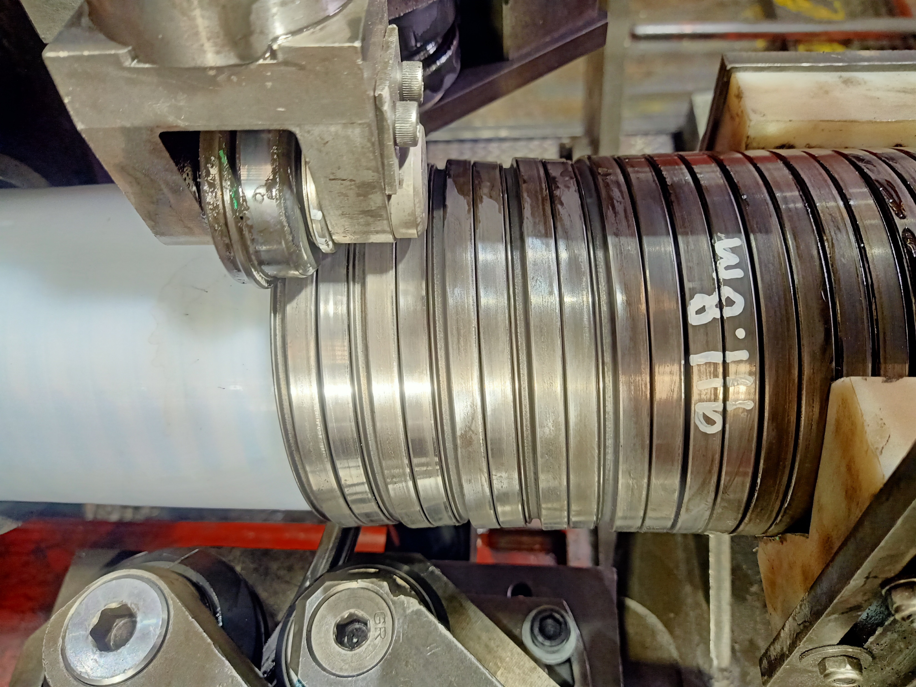
DEFECT PHOTO
Figure 1 : Zeta wire unlocked was detected at length 911.8m on the pipe.

Slide 5
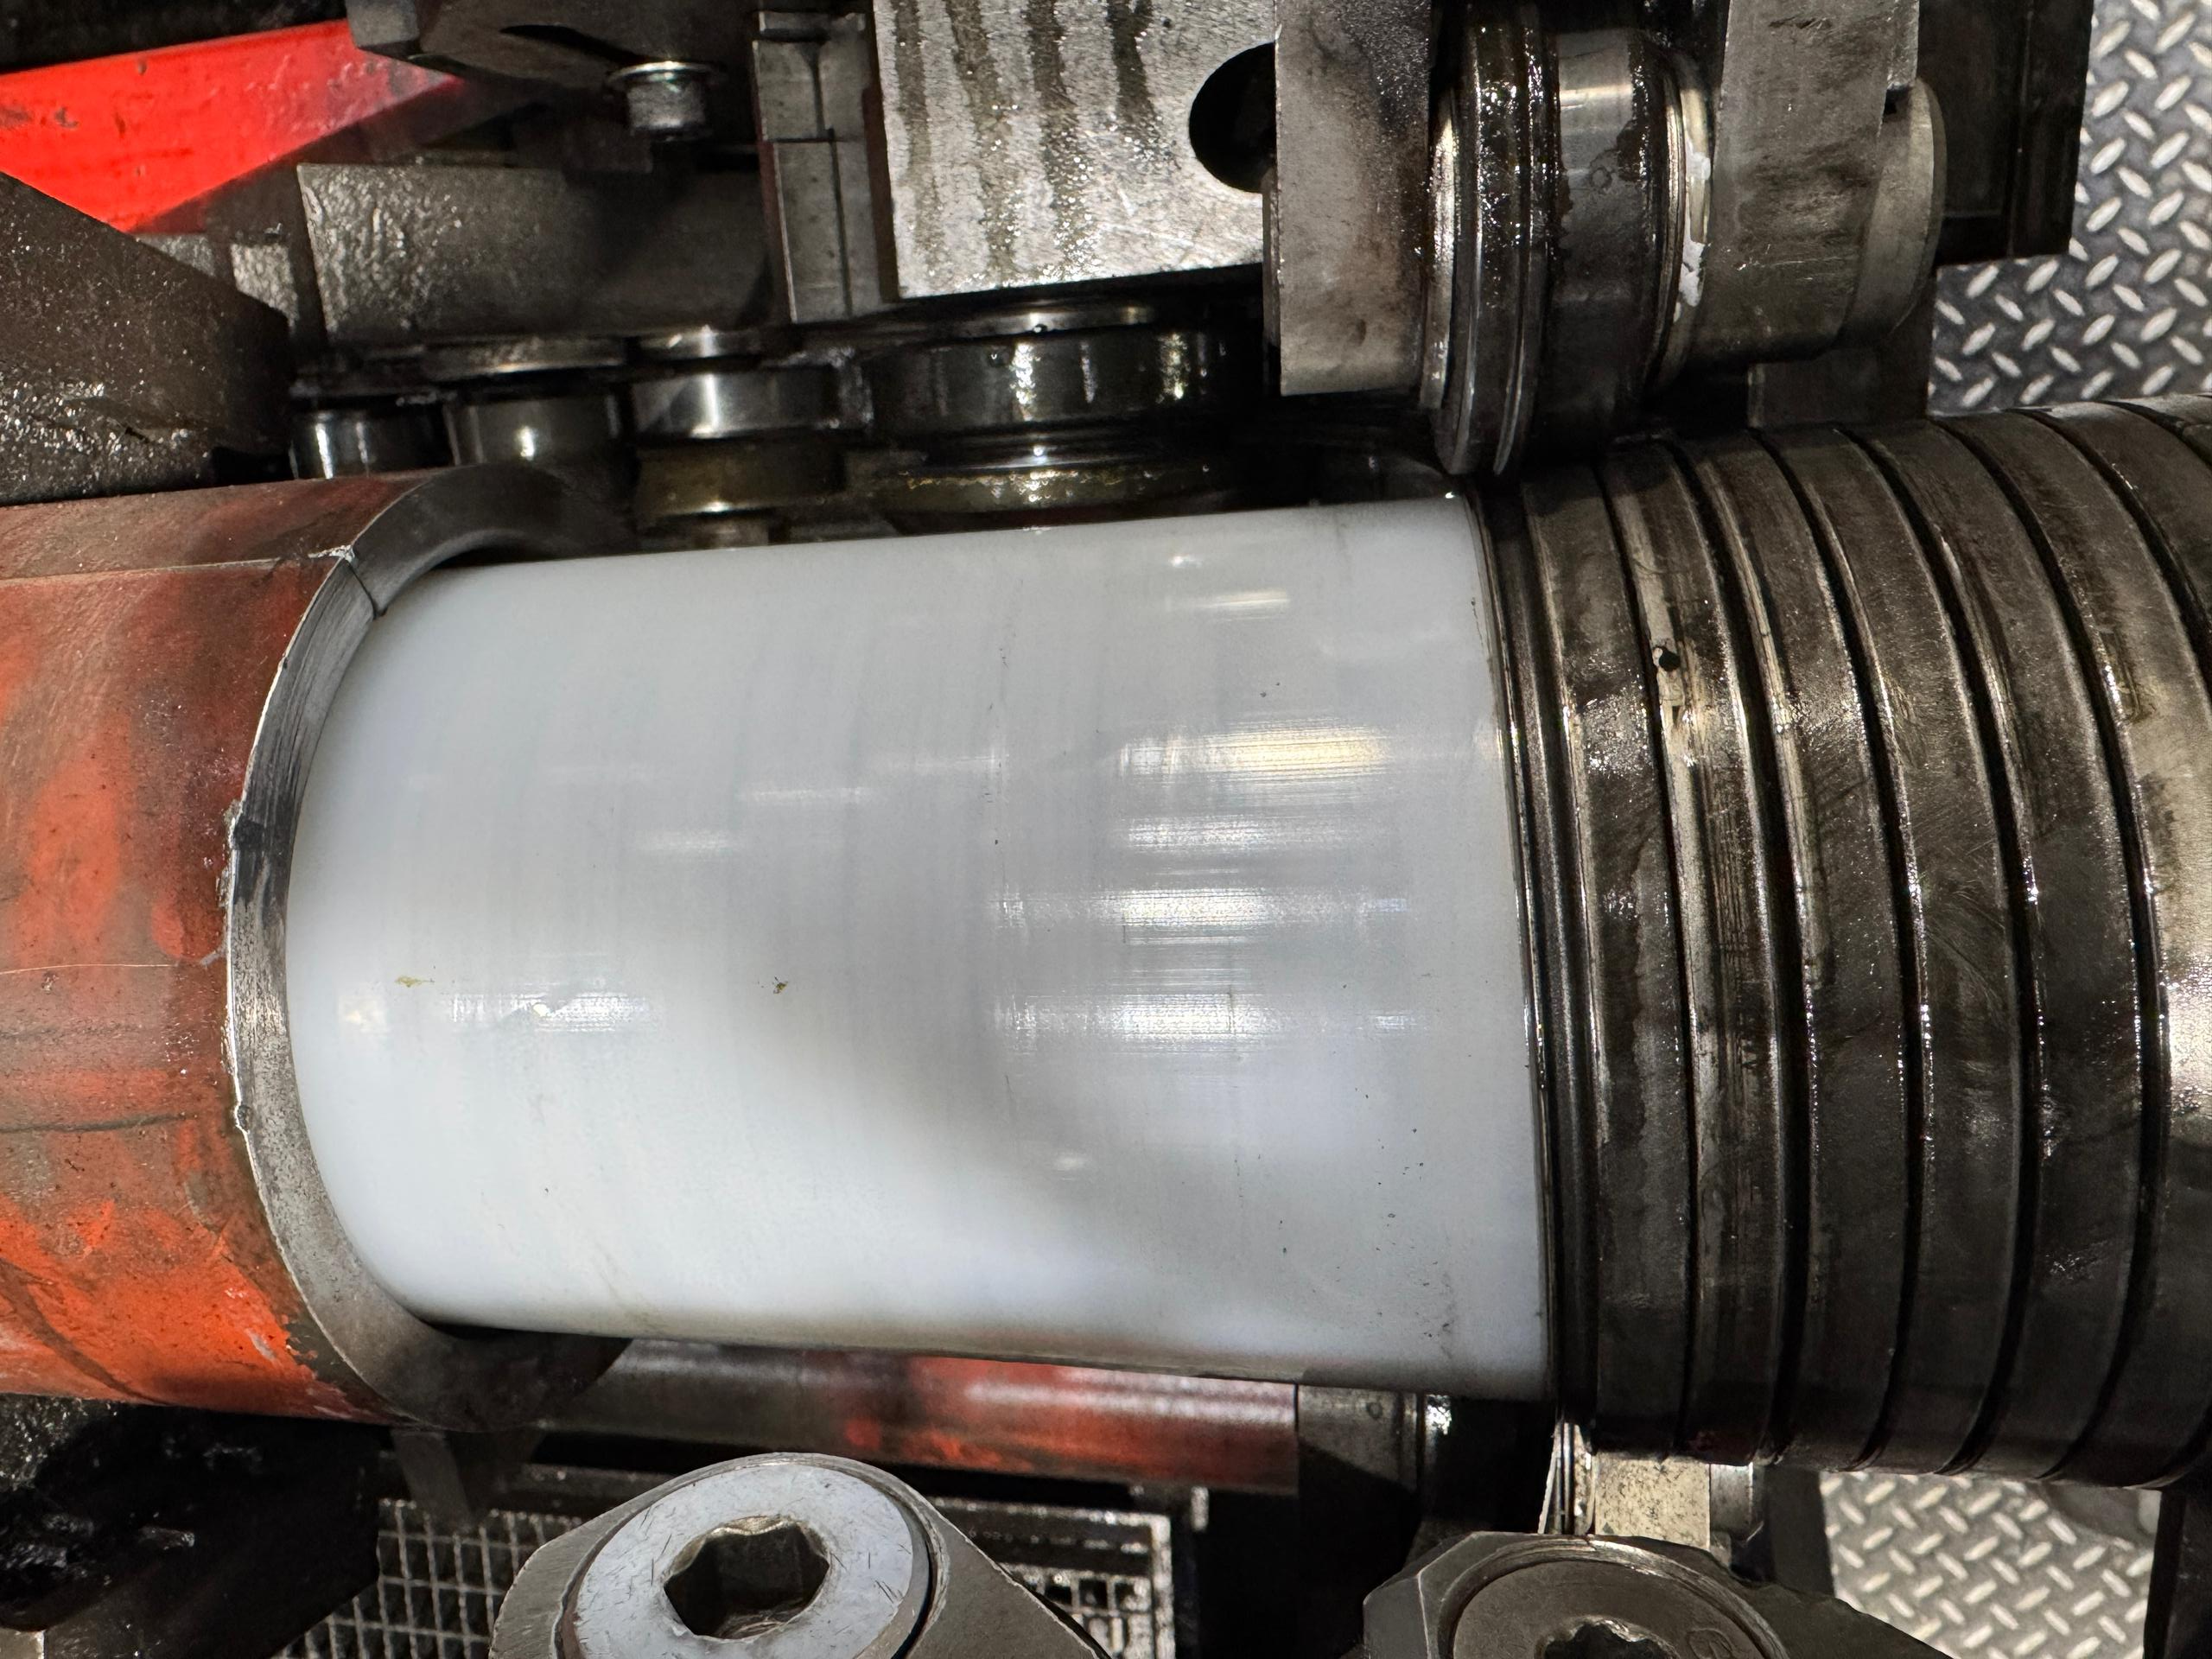
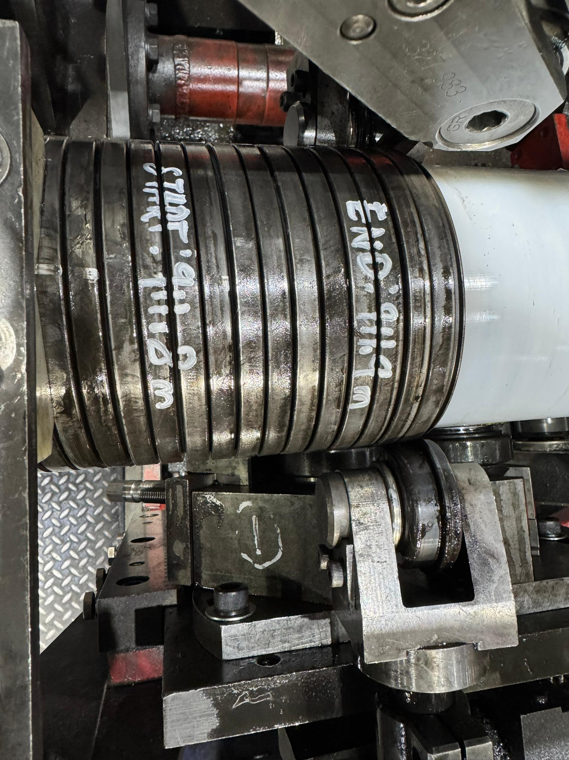
PHOTO AFTER REPAIRED
Condition of pressure sheath after complete un-spiral
Figure 2 : Reparation by un-spiral has been performed to re-position the wires to be in a good spiral. Thus, this reparation was accepted as it is and the dimensional after the repair is within the criteria.

Slide 6

THANK YOU

